Slide 1

CH 27
BIOL 1202
General Biology II Lecture
CHAPTER 27
Bacteria and Archaea
Dr. Adam Hrincevich
Notes:
Figure 27.1 Why is this lake’s water pink?
The waters of Laguna Salada de Torrevieja in Spain are many times saltier than seawater.
At certain times of the year, the water appears pink.
The color comes from trillions of living prokaryotes.

Slide 2
CH 27 Learning Objectives
Describe the possible structure of the tree of all life.
Describe structural and functional adaptations of prokaryotes.
Identify sources of genetic diversity in prokaryotes.
Give examples of nutritional and metabolic adaptations in prokaryotes.
Identify major phylogenetic groups of prokaryotes.
Describe ecological roles played by prokaryotes.
Give examples of beneficial and harmful effects that prokaryotes have on humans.
I would suggest completing the crossword puzzle to help you understand the terminology and correlate how the terms relate to topics covered in this chapter.

Slide 3
Concept 27.1: Structural and functional adaptations contribute to prokaryotic success
Prokaryotes were the first organisms to inhabit the Earth and are
They represent
They thrive almost everywhere, including places too acidic,
Most are
Most prokaryotic cells are 0.5–5 µm, much smaller than
Prokaryotic cells have
The three most common shapes are

Slide 4
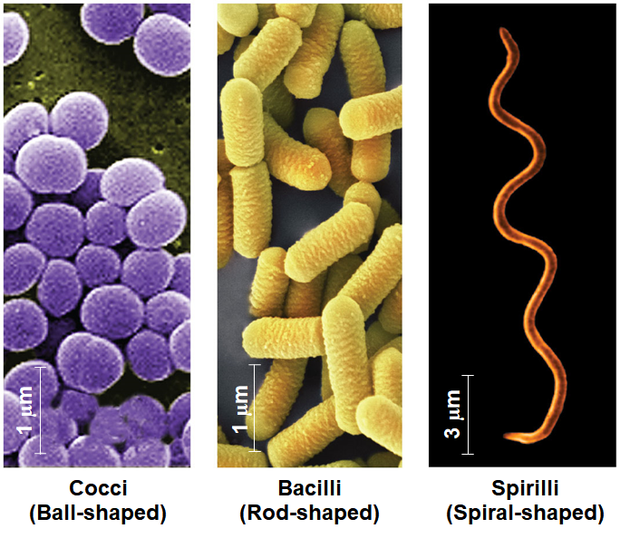
Notes:
Figure: The most common shapes of prokaryotes

Slide 5
Cell-Surface Structures
The cell wall maintains cell shape, protects, and prevents it from
Most bacterial cell walls contain peptidoglycan, a network of
Archaea contain polysaccharides and proteins but lack
Gram stain is used to classify bacteria (video here)
Gram-positive bacteria have simpler walls with a large amount of
Gram-negative bacteria have less peptidoglycan and an outer membrane that

Slide 6
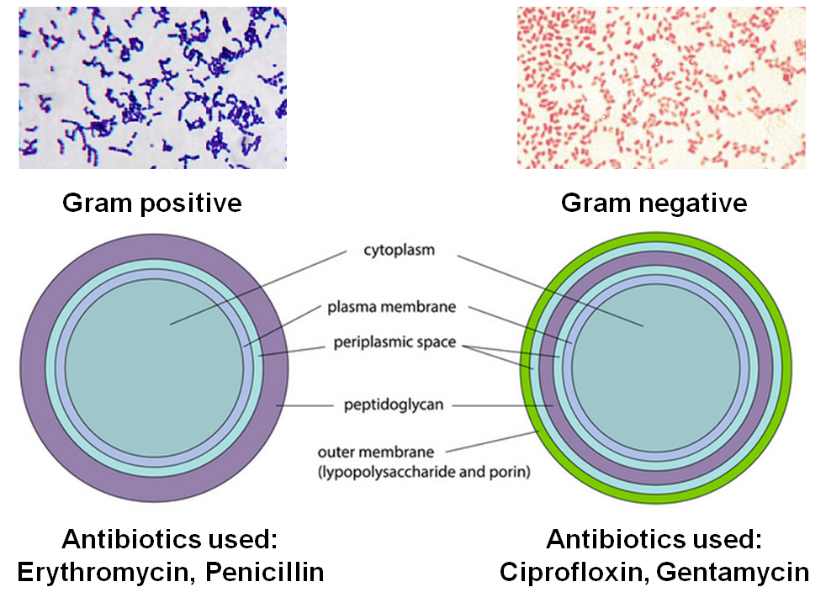
6

Slide 7
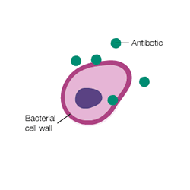
7
Many antibiotics target peptidoglycan and damage bacterial
Gram-positive bacteria are particularly susceptible to this
A sticky outer layer of polysaccharide or protein called
The capsule allows adherence to the substrate, or other individuals, and can

Slide 8
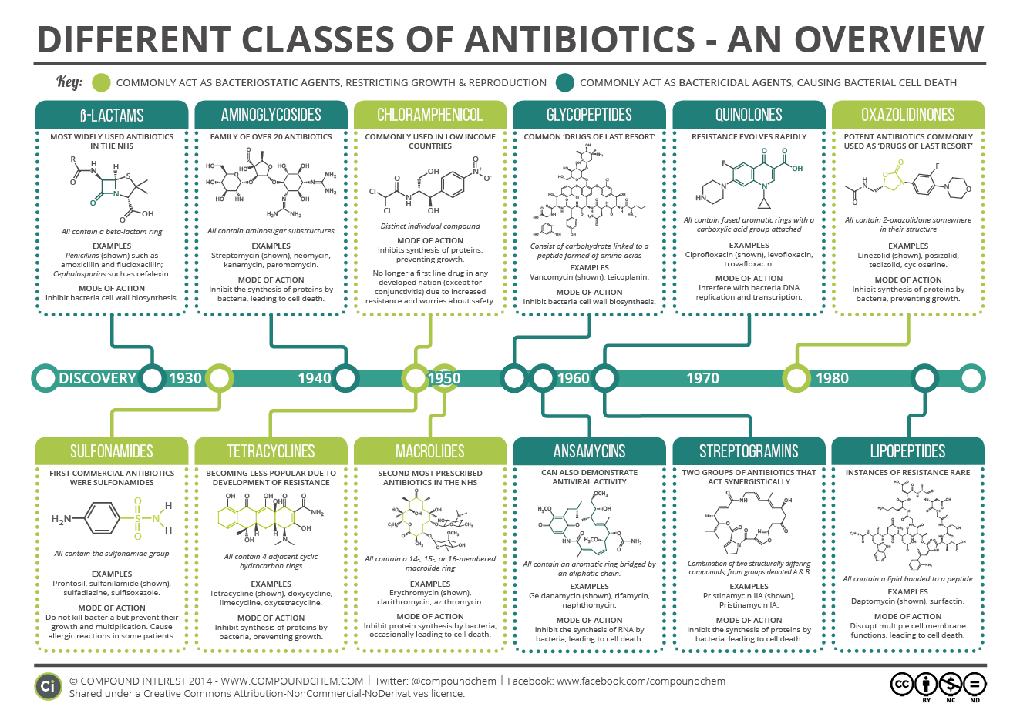
8
Good summary here about antibiotics

Slide 9
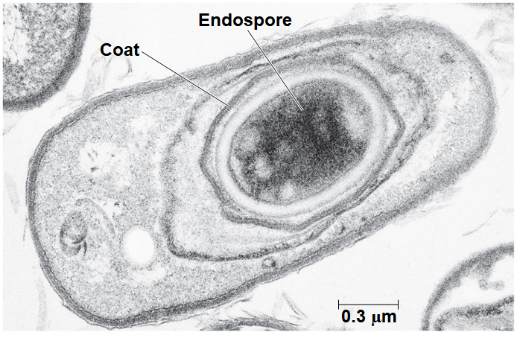
9
Many prokaryotes form metabolically inactive endospores, which can remain
Notes:
Figure 27.5 An endospore

Slide 10
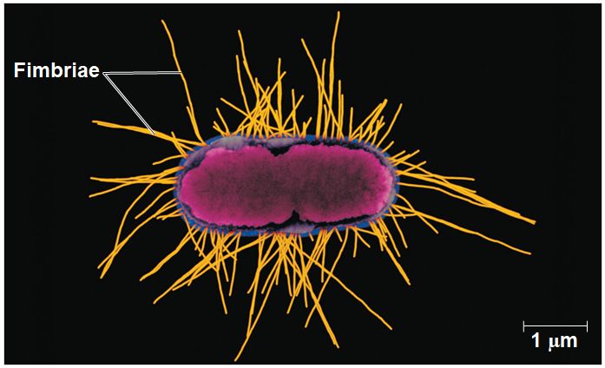
10
Some prokaryotes have hair-like appendages called fimbriae that allow them to
Pili (or sex pili) are longer than
Notes:
Figure 27.6 Fimbriae

Slide 11
Motility
About half of all prokaryotes exhibit taxis, the ability to
  EX: Chemotaxis is the movement toward or away from
Flagella are the most common structures used by prokaryotes for
Flagella may be scattered about the surface or concentrated at
The flagella of prokaryotes and eukaryotes differ in structure,
Flagella likely evolved as existing proteins were

Slide 12
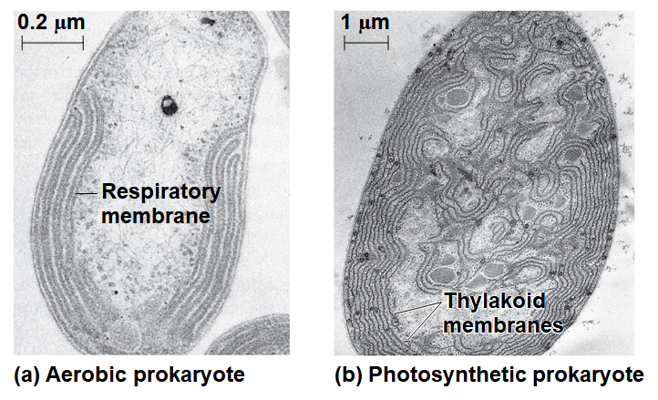
Internal Organization and DNA
Prokaryotic cells usually lack
Some prokaryotes do have
These are usually
Notes:
Figure 27.8 Specialized membranes of prokaryotes

Slide 13
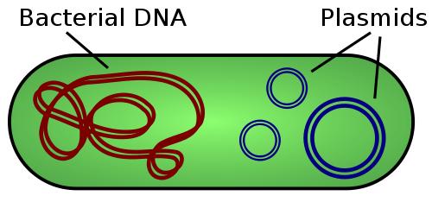
13
The prokaryotic genome has less
Most of the genome consists of a
The chromosome is not contained in a nucleus; it is located in
Typical prokaryotes also have

Slide 14
Reproduction
Prokaryotes reproduce quickly by binary fission and can divide
Some species can replicate
Early medical
Key features of prokaryote biology:
  They are
  They reproduce by
  They have

Slide 15
Concept 27.2: Rapid reproduction, mutation, and genetic recombination promote genetic diversity in prokaryotes
Diversity within and among the
Even with small genomes and
Three factors contribute to this genetic diversity:

Slide 16
Rapid Reproduction and Mutation
Prokaryotes reproduce
  EX: Escherichia coli cells reproduce using
  Mutation rates are low, but mutations accumulate rapidly because generation times are
Prokaryotes have simpler cells than eukaryotes, but their rapid adaptation to

Slide 17
Genetic Recombination
Genetic recombination, the combining of DNA from two
Movement of genes among individuals from different species is
A prokaryotic cell can take up and incorporate foreign DNA from the surrounding
Transduction is the movement of genes between bacteria by

Slide 18
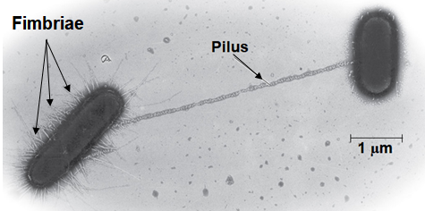
Conjugation and Plasmids
Conjugation is the process where genetic material is
In bacteria, the
A donor cell attaches to a recipient by a pilus and transfers DNA through a structure called
A piece of DNA called

Slide 19
19
The F Factor as a Plasmid or in the Chromosome
Cells containing the F plasmid function as DNA donors during
Cells without the F factor function as DNA recipients during
The F factor is
Provided some of the F plasmid’s DNA is transferred, the
A cell with the F factor built into its chromosome functions as
Called Hfr cells (for High frequency of recombination)
The recipient becomes a

Slide 20
20
R Plasmids and Antibiotic Resistance (Article)
R plasmids carry
Antibiotics kill sensitive bacteria, but not bacteria with
Through natural selection, the fraction of bacteria with genes for resistance
Many R plasmids have genes that encode pili, making it possible for resistance genes to be transferred
Most R plasmids carry
Antibiotic-resistant strains of bacteria are becoming more

Slide 21
Concept 27.3: Diverse nutritional and metabolic adaptations have evolved in prokaryotes
Prokaryotes can be categorized by how they obtain energy and
  Photoautotrophs: energy source is LIGHT; carbon source is CO₂, HCO₃⁻;
  Chemoautotrophs: energy source is INORGANIC COMPOUNDS (H₂S, NH₃, Fe²⁺⁾; carbon source is CO₂, HCO₃⁻; Sulfolobus (
  Photoheterotrophs: energy source is LIGHT; carbon source is organic compounds; Rhodobacter (
  Chemoheterotrophs: energy source is ORGANIC COMPOUNDS; carbon source is organic compounds; Clostridium (

Slide 22
The Role of Oxygen and Nitrogen in Metabolism
Prokaryotic metabolism varies
  Obligate aerobes require O₂ for
  Obligate anaerobes are poisoned by O₂ and live by fermentation or use substances other than O₂ for anaerobic
  Facultative anaerobes can use O₂ if it is present or carry out
Nitrogen is essential for the production of amino acids and
Prokaryotes can
  EX: some prokaryotes convert nitrogen gas (N₂) to ammonia (NH₃) in a

Slide 23
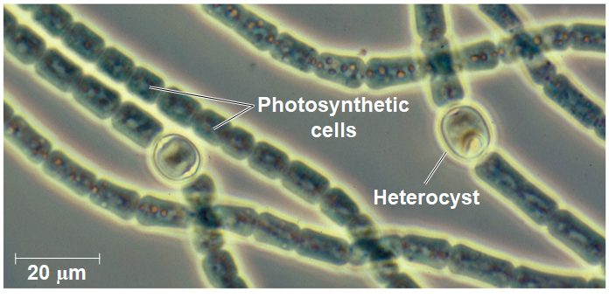
Metabolic Cooperation
Cooperation between prokaryotes allows them to use environmental resources they
In the cyanobacterium Anabaena, photosynthetic cells and nitrogen-fixing cells called heterocysts (
Notes:
Figure 27.14 Metabolic cooperation in a prokaryote

Slide 24
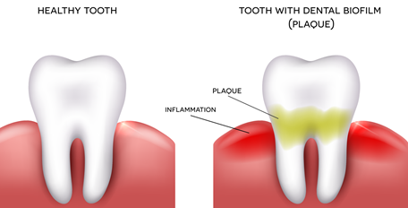
24
Metabolic cooperation occurs between different prokaryotic species in
Sulfate-consuming bacteria and methane-consuming bacteria on the

Slide 25
25
Concept 27.4: Overview of Prokaryotic Diversity
The origin of prokaryotes dates
Prokaryotes now inhabit
Genetic analysis led to the division of prokaryotes into two domains,
Advances in molecular techniques help to add new branches
The use of polymerase chain reaction has allowed for more
A handful of soil
Horizontal gene transfer between prokaryotes

Slide 26
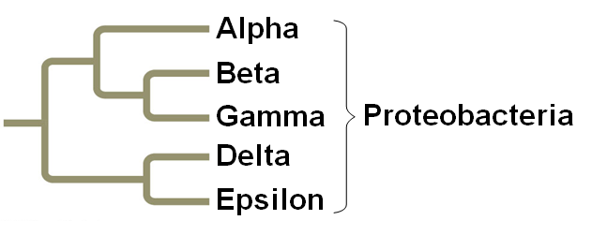
26
Proteobacteria
These gram-negative bacteria include
Some are
There are currently five subgroups of
Notes:
Figure 27.16aa Exploring selected major groups of bacteria (part 1a: proteobacteria tree)

Slide 27
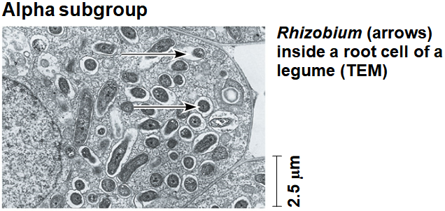
27
Subgroup: Alpha Proteobacteria
Many species are closely associated with
Scientists hypothesize that mitochondria evolved from aerobic
Rhizobium, which forms root nodules in
Agrobacterium, which produces
Notes:
Figure 27.16ab Exploring selected major groups of bacteria (part 1b: alpha subgroup)

Slide 28
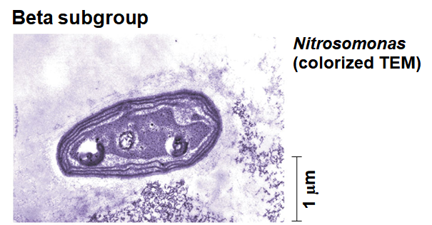
28
Subgroup: Beta Proteobacteria
This subgroup is
Nitrosomonas, a soil bacterium, converts NH₄⁺ to NO₂–
Other members include
Notes:
Figure 27.16ac Exploring selected major groups of bacteria (part 1c: beta subgroup)

Slide 29
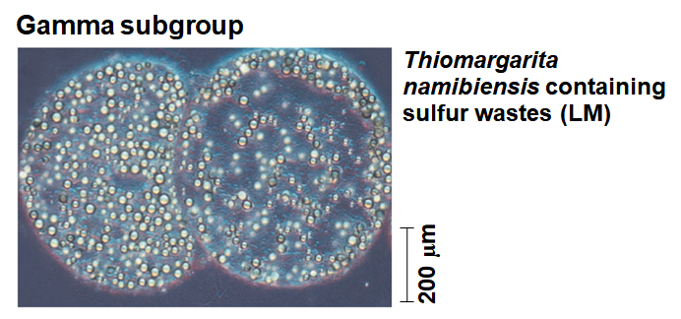
29
Subgroup: Gamma Proteobacteria
Autotrophic members include sulfur bacteria such as Thiomargarita namibiensis
Some heterotrophs are pathogenic, such as Legionella, Salmonella, and Vibrio cholerae
Escherichia coli resides in the intestines of many mammals and
Notes:
Figure 27.16ad Exploring selected major groups of bacteria (part 1d: gamma subgroup)

Slide 30
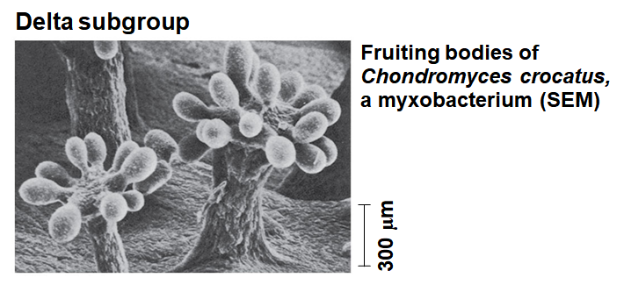
30
Subgroup: Delta Proteobacteria
The slime-secreting myxobacteria, which produces
Bdellovibrios, which mount
Notes:
Figure 27.16ae Exploring selected major groups of bacteria (part 1e: delta subgroup)

Slide 31
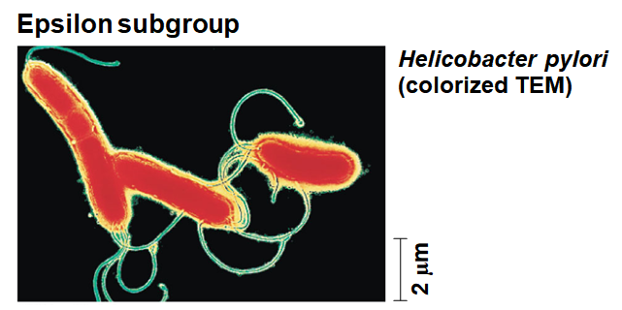
31
Subgroup: Epsilon Proteobacteria
Most species in this subgroup are
Campylobacter, which causes blood poisoning, and Helicobacter pylori, which
Notes:
Figure 27.16af Exploring selected major groups of bacteria (part 1f: epsilon subgroup)

Slide 32
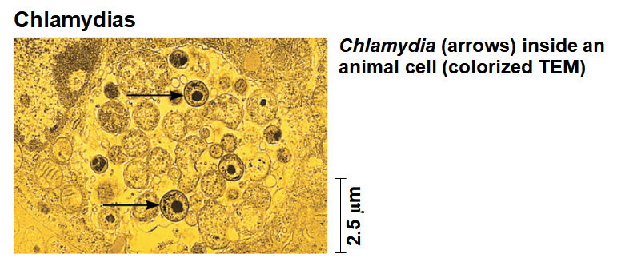
32
Chlamydias
These bacteria are parasites that live
Chlamydia trachomatis causes blindness and
Notes:
Figure 27.16ba Exploring selected major groups of bacteria (part 2a: chlamydias)

Slide 33
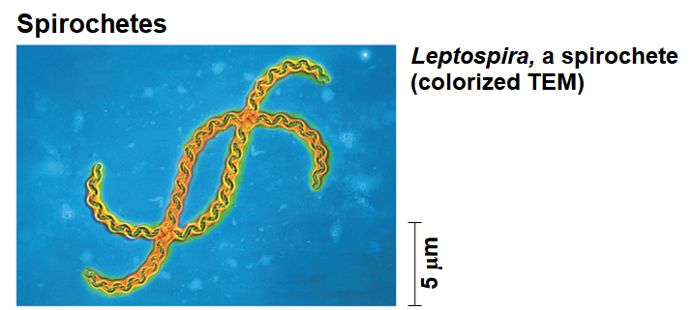
33
Spirochetes
These bacteria are
Some are parasites, including Treponema pallidum, which causes syphilis, and Borrelia burgdorferi, which causes Lyme disease
Notes:
Figure 27.16bb Exploring selected major groups of bacteria (part 2b: spirochetes)

Slide 34
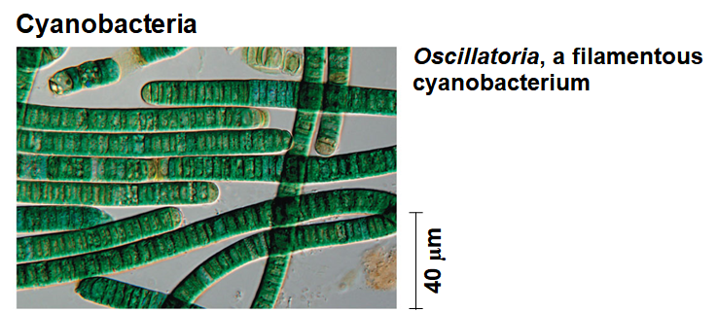
34
Cyanobacteria
These are gram-negative
Plant chloroplasts likely evolved from cyanobacteria by the
Cyanobacteria are abundant components of
Notes:
Figure 27.16bc Exploring selected major groups of bacteria (part 2c: cyanobacteria)

Slide 35
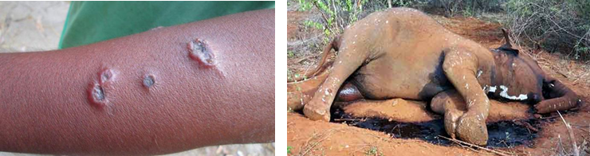
35
Gram-Positive Bacteria
Gram-positive bacteria include
  Colony-forming groups, such as actinomycetes, many of which
  Solitary species include
    Bacillus anthracis, the
    Clostridium botulinum, the
    various Staphylococcus and Streptococcus species
  Mycoplasmas, the

Slide 36

Archaea
Archaea share certain traits with
They also have many
Most archaea live in extreme environments and are
Extreme halophiles live in
Extreme thermophiles thrive in
Notes:
Figure 27.UN02 In-text figure, Archaea mini-tree, p. 580

Slide 37
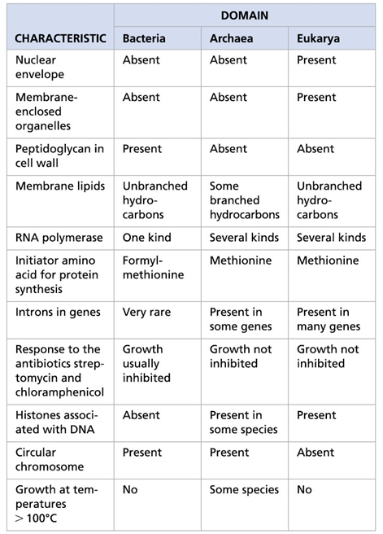
Notes:
Table: A comparison of the three domains of life

Slide 38
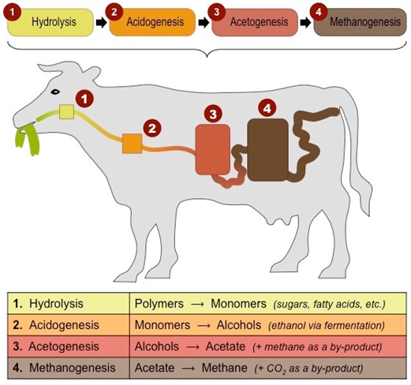
38
Methanogens live in swamps and marshes and produce
Methanogens are strict

Slide 39
Concept 27.5: Prokaryotes play crucial roles in the biosphere
Prokaryotes are so important that if they were to disappear, the prospects for any other life surviving on
Prokaryotes play a major role in the recycling of chemical elements between the living and nonliving components
Some chemoheterotrophic prokaryotes function as decomposers,
Prokaryotes can convert some molecules to forms that can be
  EX: Under some conditions, prokaryotes can increase the

Slide 40
Ecological Interactions
Symbiosis is an ecological relationship in which two species live in close contact: a
Prokaryotes often form
In mutualism, both
In commensalism, one organism benefits while neither harming nor
In parasitism, an organism called a parasite harms but
Parasites that cause

Slide 41
Concept 27.6: Prokaryotes have both beneficial and harmful impacts on humans
Some prokaryotes are human pathogens, but many others have
Human intestines are home to about
Many of these are mutualists and break down food that is
Pathogenic bacteria cause about
Some bacterial diseases are
  EX: Lyme disease is

Slide 42
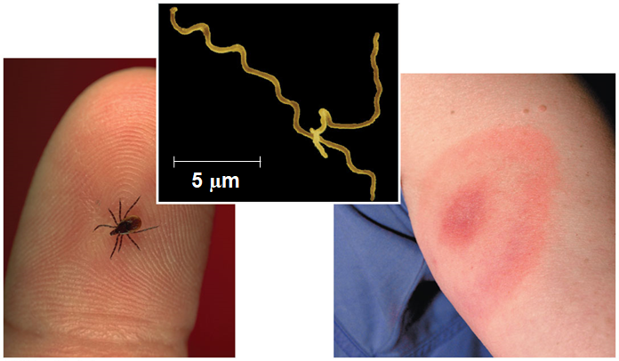
Lyme disease
Notes:
Figure 27.20 Lyme disease

Slide 43
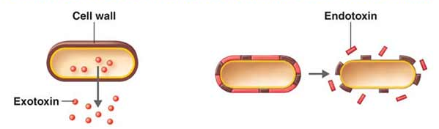
43
Pathogenic prokaryotes typically cause disease by releasing
Exotoxins are secreted and cause disease even if the
Endotoxins are released only when bacteria die and
Horizontal gene transfer can spread genes associated
  EX: pathogenic strains of E. coli contain genes that were

Slide 44
Prokaryotes in Research and Technology
Experiments using prokaryotes have led to important advances in
  EX: E. coli is
  EX: the prokaryotic CRISPR-Cas system can alter genes
Bacteria can be
Bacteria are also being engineered to produce ethanol from agricultural and
Prokaryotes can also be used in bioremediation, the use of organisms to

